Slide 1
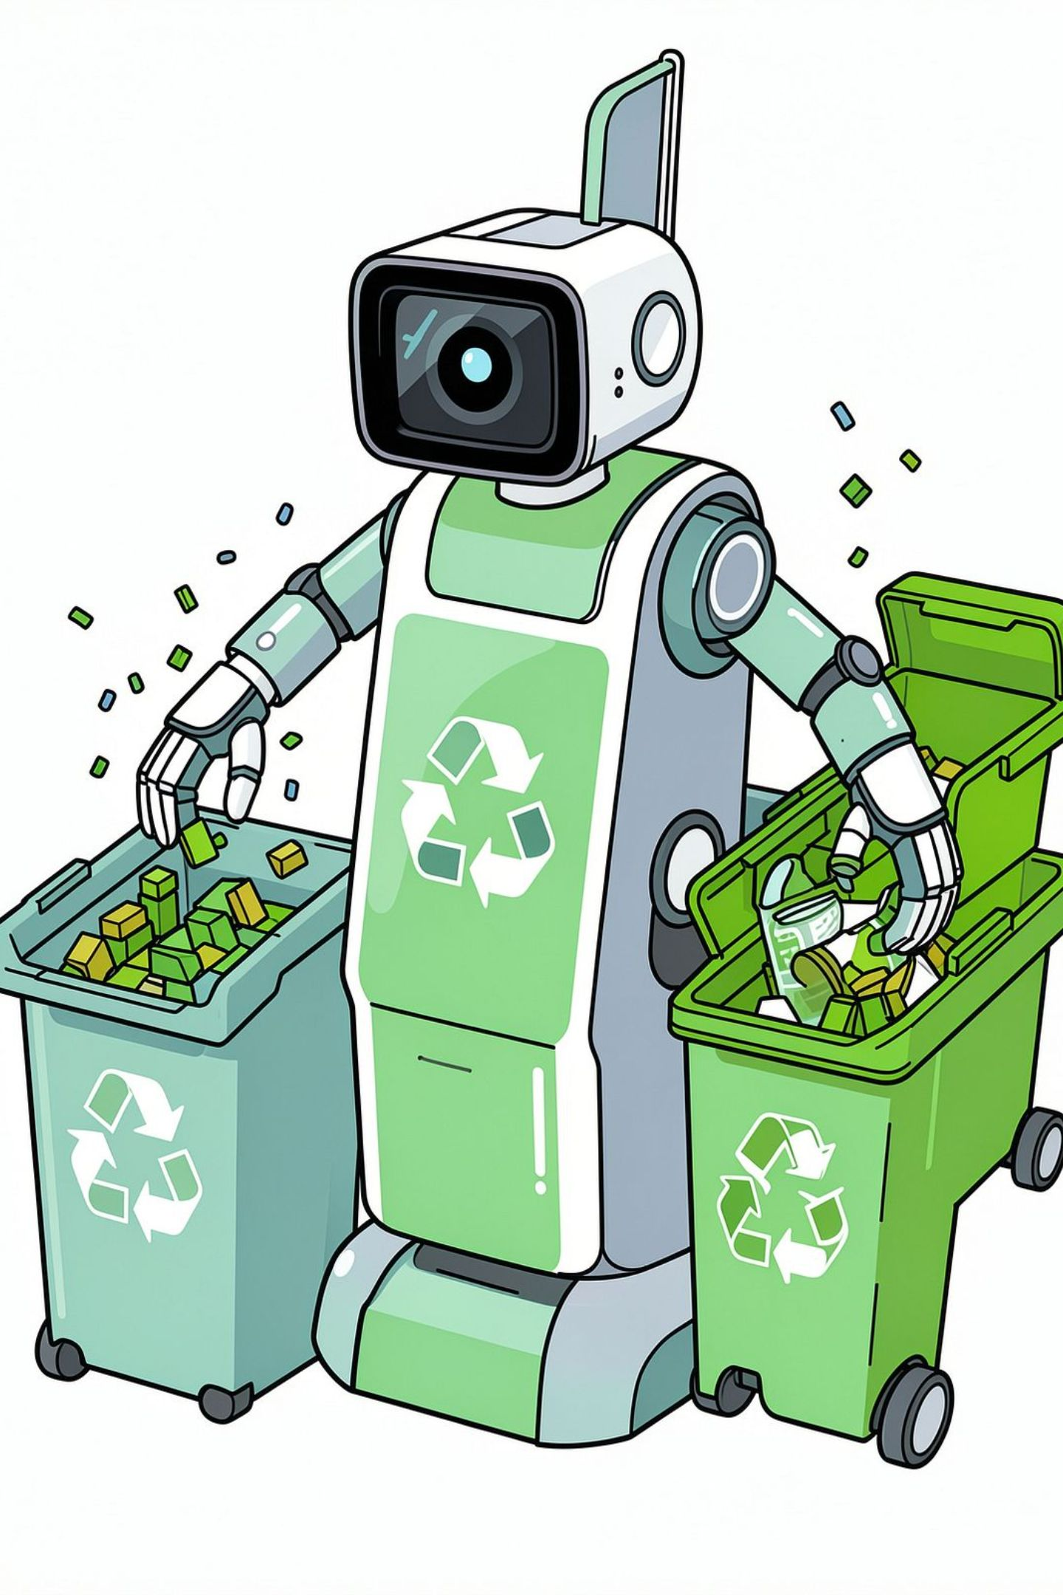
Garbage Classification Using Images
Hasibur Rahman Sun-0112330199
Nafis Iqbal Neloy-0112330617
Md. Mishkatul Bary-0112330669
Abdullah Al Muhaimin-0112330641
Farjana Akter-0112330657
Jannatul Ferdaous-0112330670

Slide 2
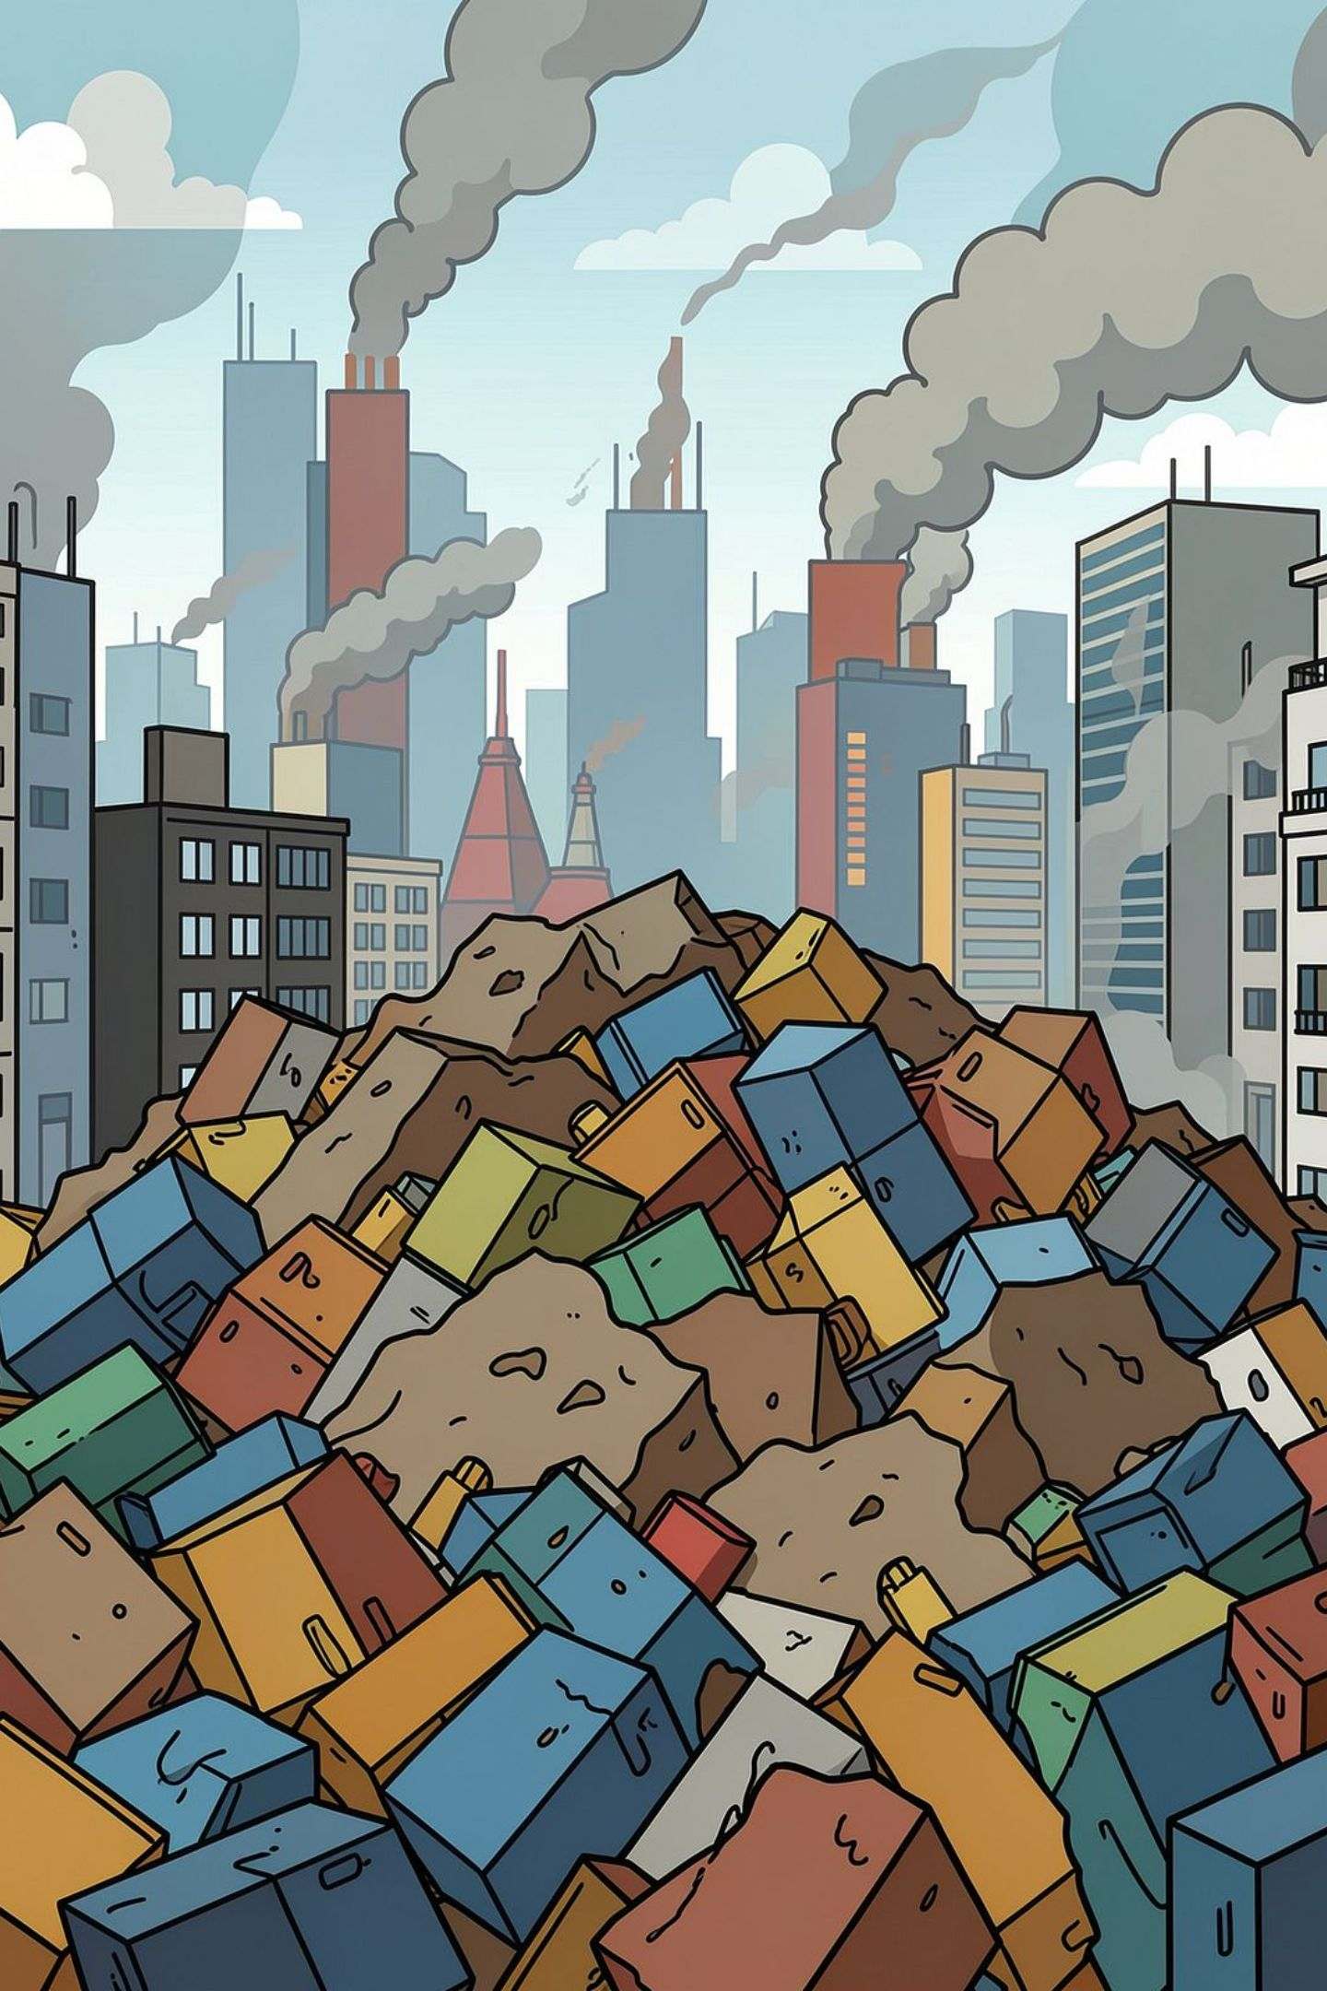
Introduction
Global waste generation is rising — improper segregation leads to pollution.
Poor sorting reduces recycling rates and increases landfill burden.
Intelligent waste management can improve resource recovery and public health.

Slide 3
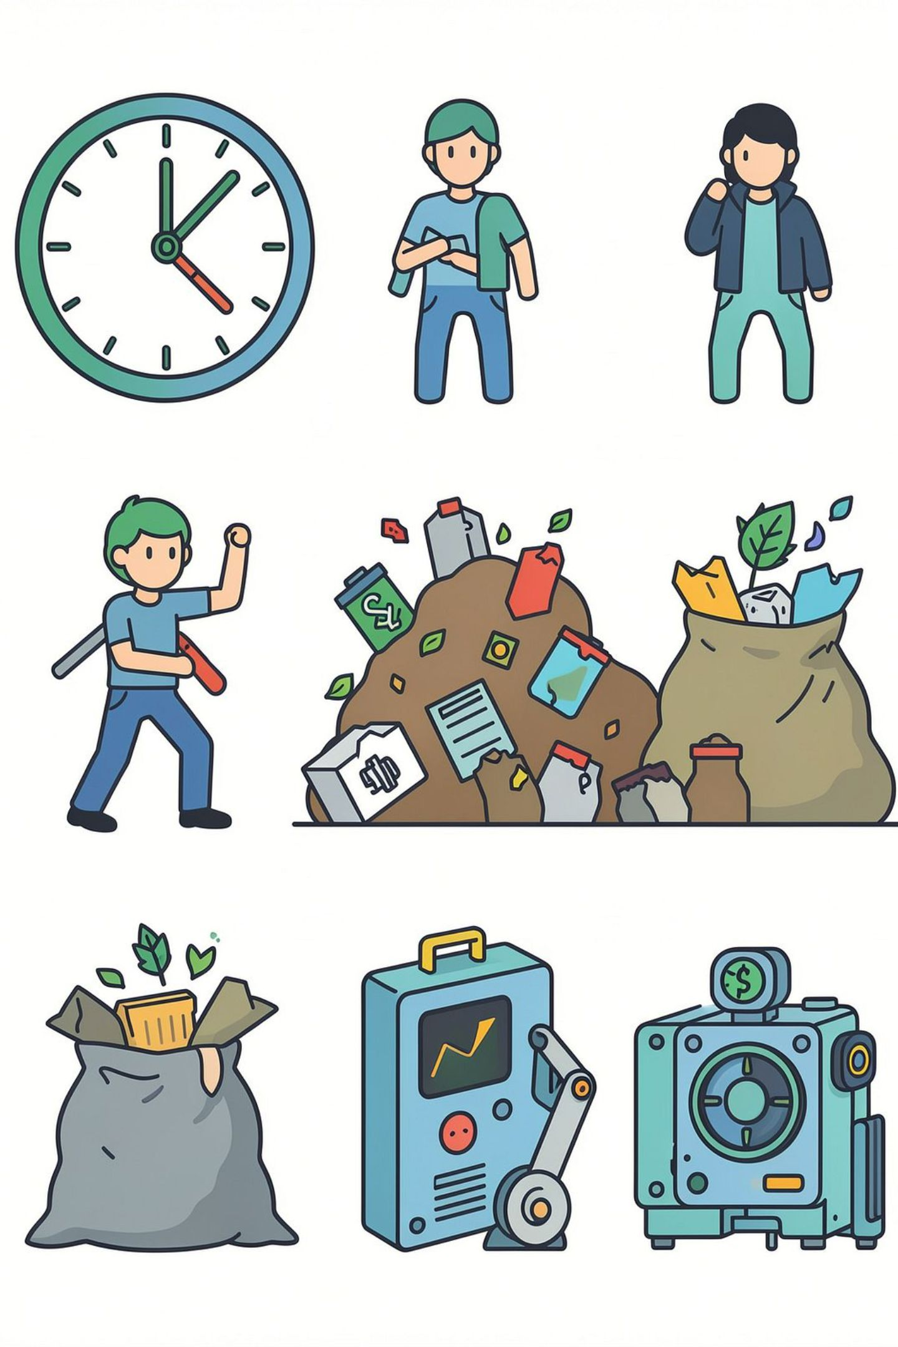
Problem Statement
Manual garbage sorting is slow and labor-intensive.
Human errors lower recycling efficiency and contaminate streams.
Waste volume is increasing; current systems struggle to scale.
We need automated, reliable classification to boost recycling rates.

Slide 4
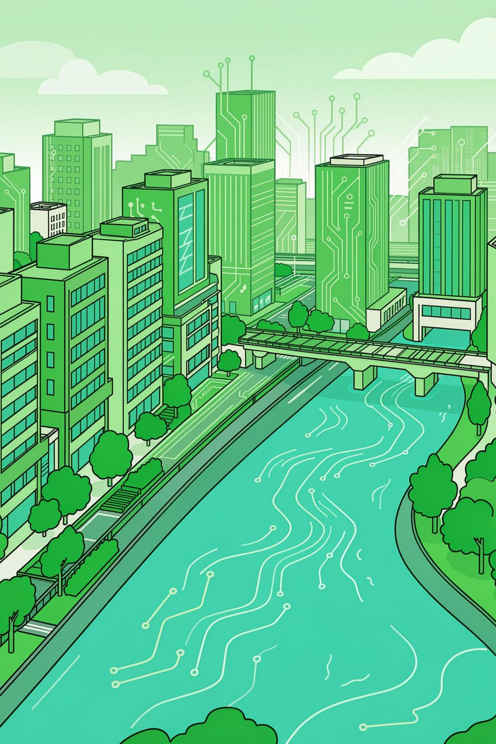
Motivation
Environmental sustainability: reduce landfill and pollution.
Enable smart recycling systems across cities and facilities.
Reduce manual effort and exposure to hazardous waste.
Demonstrate applied AI solving a tangible societal problem.

Slide 5
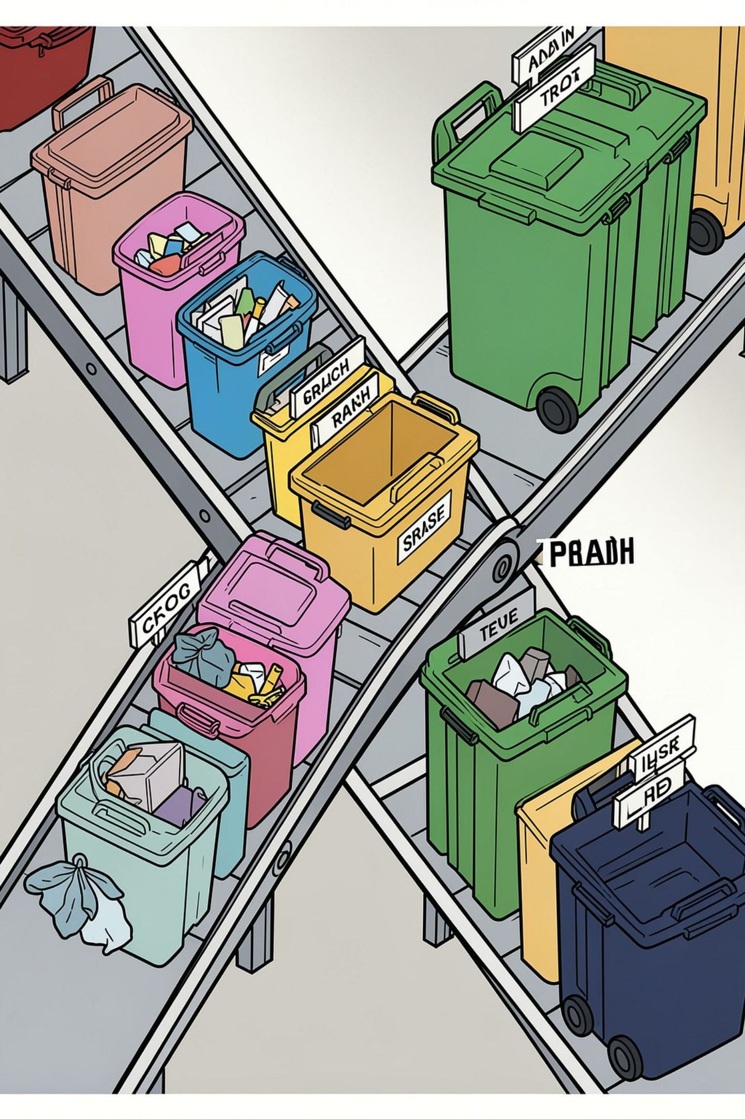
Project Objectives
Main Objective
Specific Goals
Develop an AI-powered system that classifies garbage using deep learning.
Automatic waste classification (multi-class).
Improve recycling accuracy and throughput.
Reduce manual sorting effort and contamination.
Showcase computer vision techniques for coursework.

Slide 6






Proposed Solution: Workflow
Garbage Image
High-resolution image capture of waste items.
Image Preprocessing
Resize, normalize, and augment images for model compatibility.
CNN Model
Convolutional Neural Network infers waste category.
Prediction
Model outputs the most probable garbage type.
Garbage Category
Identified category guides automated sorting action.

Slide 7

Collect
Preprocess
Train CNN
Validate
Deploy
Each step builds on the previous: collect labeled images → clean & augment → train CNN (transfer learning) → validate with metrics → deploy for real-time prediction.

Slide 8





Methodology
Our project follows a structured methodology to ensure robust model development and evaluation:
Dataset Collection
Image Preprocessing
Train CNN Model
Gathering a diverse and representative image dataset of various waste categories.
Resizing, normalizing, and augmenting images to optimize for CNN training.
Developing and training a Convolutional Neural Network for accurate classification.
Model Testing
Prediction
Rigorously evaluating model performance using unseen data and key metrics.
Applying the trained model to predict waste categories for sorting.
This systematic approach ensures each stage is thoroughly developed and validated, building a reliable classification system.

Slide 9

Technologies
Python — primary implementation language
TensorFlow & Keras — model building and training
Convolutional Neural Networks (CNNs) — core architecture
NumPy & Matplotlib — data handling and visualization
Jupyter Notebook / Google Colab — experimentation and prototyping

Slide 10
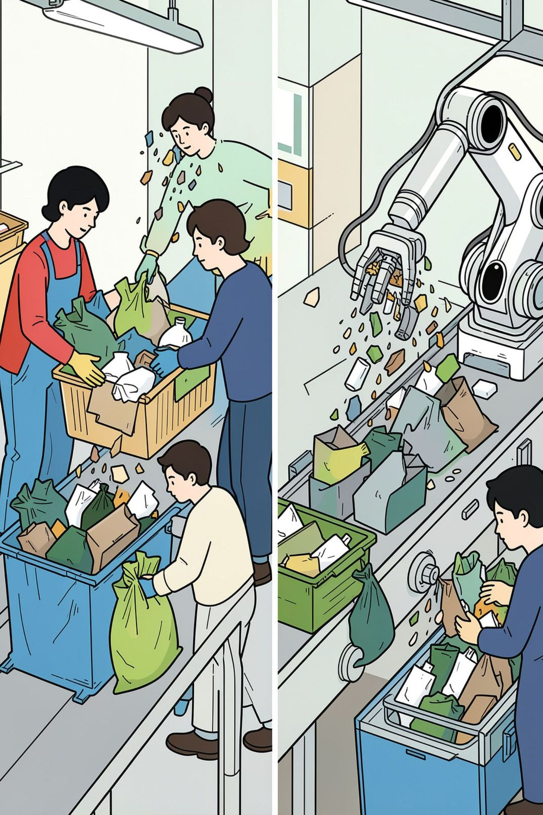
Expected Outcomes
High-accuracy garbage classification (objective: measurable improvement over manual sorting).
Faster sorting throughput and reduced contamination.
Lower human labor and exposure to hazardous items.
Clear pathway from prototype to deployment in sorting lines or bins.

Slide 11
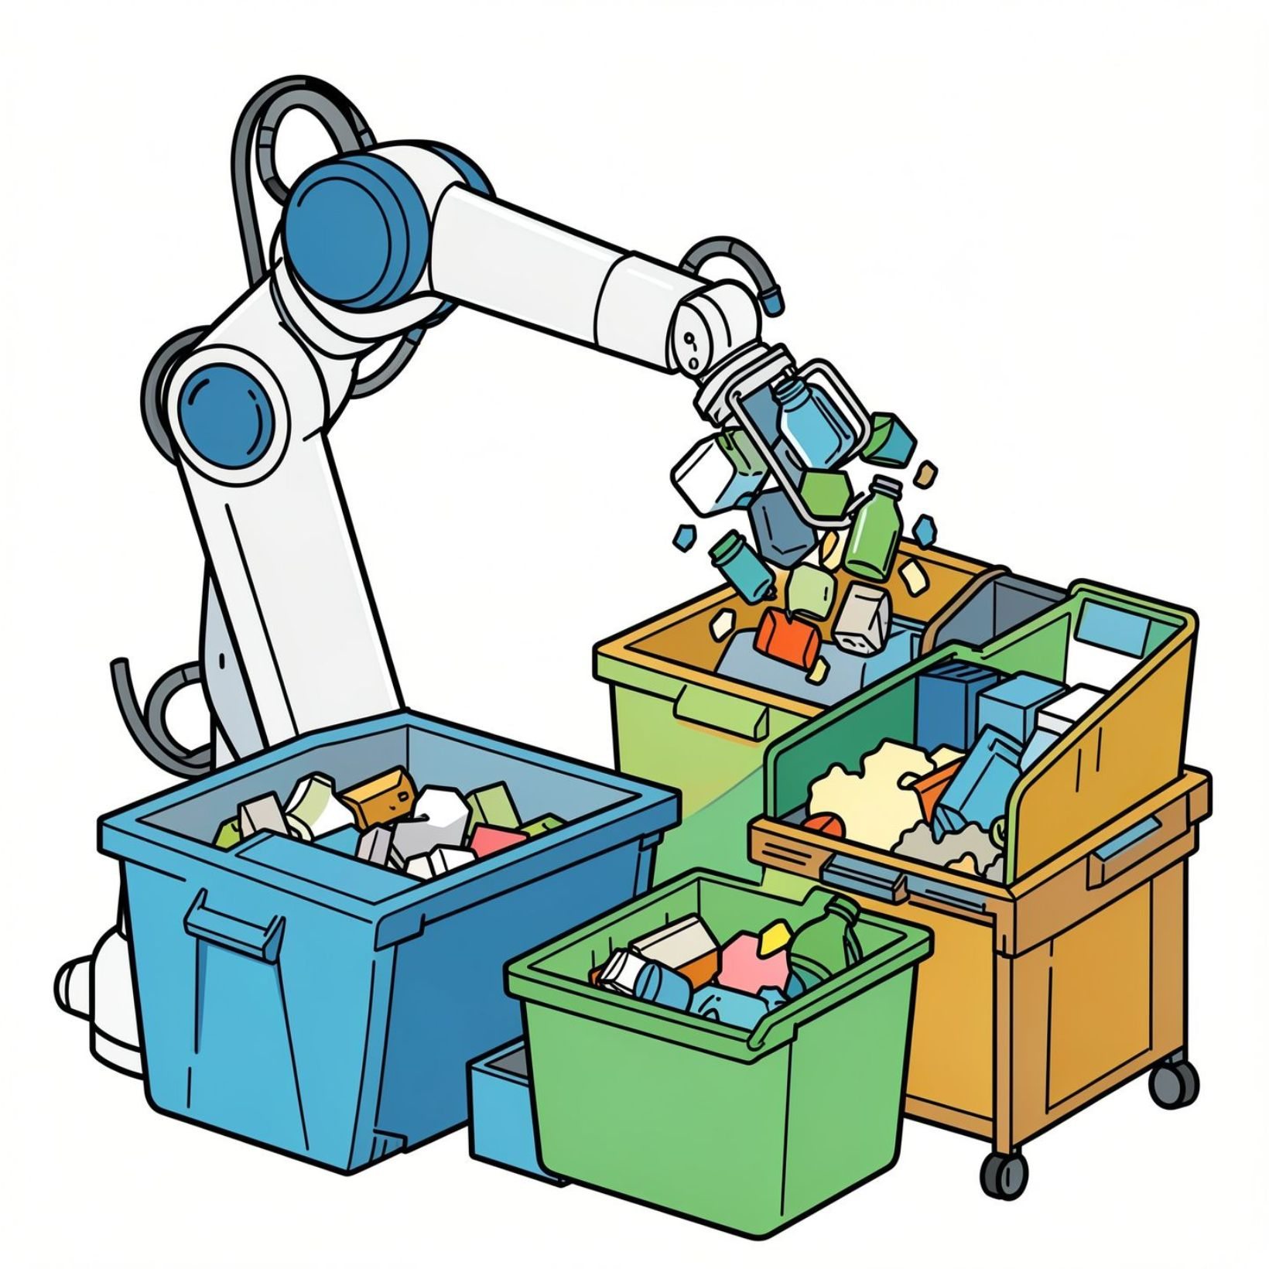
Applications & Future Scope
Smart dustbins and curbside sorting
Automation in recycling plants and smart cities
Educational tools demonstrating AI for sustainability
Future: mobile apps, IoT cameras, real-time detection, robotic sorting

Slide 12


Conclusion
Our Proposal
Our project delivers a comprehensive solution to enhance waste management:
AI-Based Garbage Classification
Leveraging deep learning for accurate waste identification.
Automatic Waste Segregation
Enabling automated sorting to minimize human intervention.
Improved Recycling Efficiency
Boosting rates and purity of recycled materials.
Thank You!
Questions?

